Slide 1
DataBase

Slide 2
DataBase Design
Database Design Theory and Normalization

Slide 3
Design of Relational DataBase Structures

Slide 4
relation schema consists of a number of attributes
relational database schema consists of number of relation schemas
assumed that attributes are grouped to form relation schema by using the common sense of the DataBase Adminstrator DBA database designer or by mapping database schema design from conceptual data model such as ER or Enhanced-ER data model
designer identify entity types and relationship types and their respective attributes, which leads to natural and logical grouping of attributes into relations

Slide 5
need some formal way of analyzing why one grouping of attributes into relation schema may be better than another
develop any measure of appropriateness or goodness to measure quality of design

Slide 7
“Data modeling is not optional”
no database or system was ever built without at least an implicit model

Slide 8
software programs are designed to implement a process model (or functional specification)
  specifying business processes that the system is to perform
same way, database is specified by data model, describing what sort of data will be held and how it will be organized

Slide 9
Design – Choice & Creativity
in design, we do not expect to find a single correct answer, although we will certainly be able to identify many that are incorrect
2 data modelers given same set of requirements may produce quite different solutions

Slide 10
First choice of what symbols or codes we use to represent real-world facts in database
person’s age could be represented by Birth Date, Age at Date of …, or even by code corresponding to range

Slide 11
Second choice there is usually more than one way to organize (classify) data
  into tables and columns in relational model

Slide 12
Third choice requirements from which we work in practice are usually incomplete, or at least loose enough to accommodate a variety of different solutions

Slide 13
Fourth choice we have some options as to which part of system will handle each business requirement

Slide 14
Finally, and perhaps most importantly
  new information systems seldom deliver value simply by automating current way of doing things
to exploit information technology fully, we generally need to change our business processes and data required to support them
data modeler becomes a player in helping to design new way of doing business, rather than merely reflecting the old

Slide 15
We want you to learn not only to produce sound, workable models (that will not fall down) but to be able to develop and compare different options
not throw away rule book, not suggest that anything goes

Slide 16
Data Model Important
Leverage
Conciseness
Data Quality

Slide 17
Leverage
small change to data model may have major impact on system as whole
programs are far more complex and take longer to specify and construct than database
  their content and structure are heavily influenced by database design

Slide 18
Leverage
well-designed data model can make programming simpler and cheaper
poor data organization can be expensive to fix

Slide 19
Conciseness
data model is powerful tool for expressing information systems requirements and capabilities
implicitly defines whole set of screens, reports, and processes needed to capture, update, retrieve, and delete specified data

Slide 20
Data Quality
database is usually valuable business asset built up over long period
establishing common understanding of what is to be held in each table and column, and how it is to be interpreted
problems with data quality can be traced to lack of consistency
  in defining and interpreting data
  implementing mechanisms to enforce definitions

Slide 21
What Makes a Good Data Model?
Completeness
Non-redundancy
Enforcement of Business Rules
Data Reusability
Stability and Flexibility
Elegance
Communication
Integration
Conflicting Objectives
Performance

Slide 22
Completeness
Does the model support all the necessary data?

Slide 23
Non-redundancy
Does the model specify a database in which the same fact could be recorded more than once?

Slide 24
Enforcement of Business Rules
How accurately does the model reflect and enforce the rules that apply to the business’ data?

Slide 25
Data Reusability
Will data stored in database be re-useable for purposes beyond those anticipated in process model?
once an organization has captured data to serve particular requirement, other potential uses and users almost invariably emerge

Slide 26
Stability and Flexibility
How well will the model cope with possible changes to business requirements?
can any new data required to support such changes be accommodated in existing tables?
  or will we be forced to make major structural changes, with corresponding impact on the rest of the system?

Slide 27
Stability and Flexibility
data model is stable in the face of a change to requirements if we do not need to modify it at all
  we can talk of models being more or less stable, depending on level of change required
data model is flexible if it can be readily extended to accommodate likely new requirements with only minimal impact on existing structure

Slide 28
Elegance
Does the data model provide a reasonably neat and simple classification of the data?
simple
consistent
easily described and summarized

Slide 29
Communication
How effective is the model in supporting communication among various stakeholders in the design of a system?
Do tables and columns represent business concepts that users and business specialists are familiar with and can easily verify?
Will programmers interpret model correctly?

Slide 30
Integration
How will the proposed database fit with organization’s existing and future databases?
  common for the same data to appear in more than one database and for problems to arise
How easy is it to keep different versions in step, or to assemble a complete picture?

Slide 31
Conflicting Objectives
above aims will conflict with one another
elegant but radical solution may be difficult to communicate to conservative users
can be attracted to elegant model that we exclude requirements that do not fit
model that accurately enforces large number of business rules will be unstable if some rules change
model that is easy to understand because (reflects perspectives of immediate system users) may not support reusability or integrate well with other

Slide 32
Performance
system user will not be satisfied if our complete, non-redundant, flexible, and elegant database cannot meet throughput and response-time requirements
differs from our other criteria because it depends heavily on software and hardware platforms on which database will run
  exploiting their capabilities is technical task
  quite different from more business-focused modeling

Slide 33
Performance
performance requirements are usually “added to the mix” at a later stage than other criteria, and then only when necessary
usual (and recommended) procedure is to develop data model without considering performance
attempt to implement it with available hardware and software
if it is not possible to achieve adequate performance in this way do we consider modifying the model itself

Slide 34
there are two levels at which we can discuss the goodness of relation schemas
first is the logical (or conceptual) level - how users interpret relation schemas and meaning of their attributes; enables users to understand clearly the meaning of the data in the relations, and hence to formulate their queries correctly
second is the implementation (or physical storage) level - how the tuples in a base relation are stored and updated

Slide 35
second level applies only to schemas of base relations, which will be physically stored, whereas at the logical level we are interested in schemas of both base relations and views (virtual relations)
relational database design theory presented next applies mainly to base relations, although some criteria of appropriateness also apply to views

Slide 36
bottom-up design methodology
design by synthesis
considers basic relationships among individual attributes as the starting point and uses those to construct relation schemas
approach is not very popular in practice because it suffers from the problem of having to collect a large number of binary relationships among attributes at starting point; for practical situations, it is next to impossible to capture binary relationships among all such pairs of attributes

Slide 37
top-down design methodology
design by analysis
starts with number of groupings of attributes into relations that exist together naturally
relations are then analyzed, leading to further decomposition until all desirable properties are met
appropriate when performing design of databases by analysis and decomposition of sets of attributes that appear together in real-life situations

Slide 38
we need to store in database all the information that it is needed
we need to store in database only the information that it is needed once

Slide 39
relational database design ultimately produces a set of relations
goal of design are information preservation and minimum redundancy
information preservation: maintaining all concepts, including attribute types, entity types, and relationship types as well as generalization/specialization relationships, described using model such as EER model
relational design must preserve all concepts captured in conceptual design
minimizing redundancy: minimizing redundant storage of same information and reducing need for multiple updates to maintain consistency across multiple data copies of same information in response to real-world events that require making an update

Slide 40
Design Guidelines for Relation Schemas
semantics of attributes is clear in schema
reduce redundant information in tuples
reduce NULL values in tuples
disallow possibility to generate bogus tuples

Slide 41
Guide (in German language die Datenbank führer)
design a relation schema so that it is easy to explain its meaning
if relation schema corresponds to one entity type or one relationship type, it is straightforward to explain its meaning
if relation corresponds to mixture of multiple entities and relationships, semantic ambiguities will result and relation cannot be easily explained

Slide 42
Redundant Information in Tuples
Update Anomalies
one goal of schema design is to minimize storage space used by the base relations
grouping attributes into relation schemas has a significant effect on storage space

Slide 43
compare space used by two base relations EMPLOYEE and DEPARTMENT

Slide 44
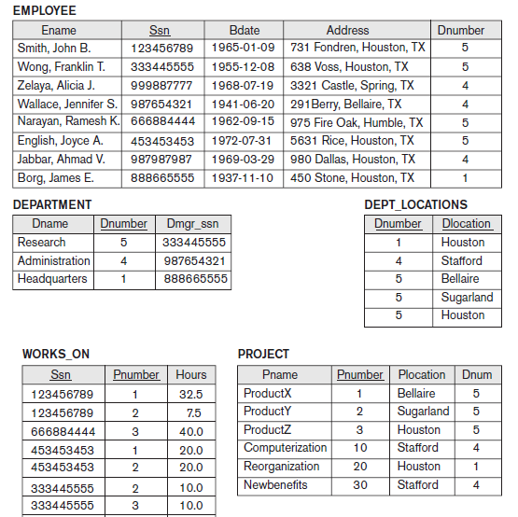

Slide 45
with that for an EMP_DEPT base relation
which is the result of applying NATURAL JOIN operation to EMPLOYEE and DEPARTMENT

Slide 46
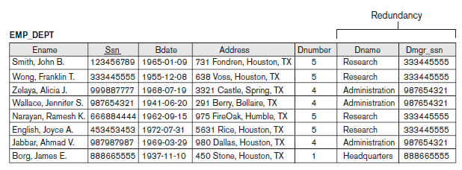

Slide 47
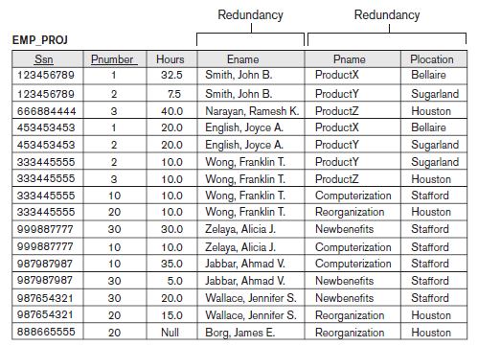

Slide 48
in EMP_DEPT, attribute values pertaining to particular department (Dnumber, Dname, Dmgr_ssn) are repeated for every employee who works for that department
in contrast, each department’s information appears only once in the DEPARTMENT relation in first version and only department number (Dnumber) is repeated in EMPLOYEE relation for each employee who works in that department as a foreign key
similar comments apply to the EMP_PROJ relation

Slide 49
storing natural joins of base relations leads to additional problem referred to as update anomalies
  can be classified into insertion anomalies, deletion anomalies, and modification anomalies

Slide 50
Insert Anomalies
to insert new employee tuple into EMP_DEPT, we must include either the attribute values for the department that the employee works for, or NULLs (if employee does not work for a department as yet)
  must enter all attribute values of department correctly so that they are consistent with corresponding values for department in other tuples
difficult to insert new department that has no employees as yet in the EMP_DEPT relation; only way to do this is to place NULL values in attributes for employee –violates entity integrity
problems does not occur in the normal design

Slide 51
Delete Anomalies
if we delete from EMP_DEPT an employee tuple that happens to represent last employee working for particular department, the information concerning that department is lost inadvertently from the database
problems does not occur in the normal design because DEPARTMENT tuples are stored separately

Slide 52
Modification – Update - Anomalies
in EMP_DEPT, if we change the value of one of the attributes of particular department we must update the tuples of all employees who work in that department; otherwise, database will become inconsistent
  if we fail to update some tuples, same department will be shown to have two different values for attribute in different employee tuples
these three anomalies are undesirable and cause difficulties to maintain consistency of data as well as require unnecessary updates that can be avoided

Slide 53
Guideline
design the base relation schemas so that no insertion, deletion, or modification anomalies are present in the relations
if any anomalies are present make sure that programs that update the database will operate correctly
guidelines may sometimes have to be violated in order to improve the performance of certain queries

Slide 54
NULL Values in Tuples
in some schema designs we may group many attributes together into a “fat” relation; if many of the attributes do not apply to all tuples in relation, we end up with many NULLs in those tuples
waste space and may also lead to problems with understanding meaning of attributes

Slide 55
Guideline
as far as possible, avoid placing attributes in a base relation whose values may frequently be NULL
if NULLs are unavoidable, make sure that they apply in exceptional cases only and do not apply to a majority of tuples in relation

Slide 56
Guideline
design relation schemas so that they can be joined with equality conditions on attributes that are appropriately related (primary key, foreign key) pairs in a way that guarantees that no spurious tuples are generated
avoid relations that contain matching attributes that are not (foreign key, primary key) combinations because joining on such attributes may produce spurious tuples

Slide 57
anomalies that cause redundant work to be done during modification of a relation, and that may cause accidental loss of information
waste of storage space due to NULLs and difficulty of performing selections, aggregation operations, and joins due to NULL values
generation of invalid and spurious data during joins on base relations with matched attributes that may not represent a proper (foreign key, primary key) relationship

Slide 58
Functional Dependencies

Slide 59
Functional Dependency
formal tool for analysis of relational schemas that enables us to detect and describe some of the above-mentioned problems in precise terms
a functional dependency definition: it is a constraint between two sets of attributes from the database
relational database schema has n attributes A₁, A₂, … , A_{n}; let us think of the whole database as being described by single universal relation schema R = {A₁, A₂, … , A_{n}}

Slide 60
Functional Dependency Definition
functional dependency, denoted by X → Y, between two sets of attributes X and Y that are subsets of R specifies a constraint on the possible tuples that can form a relation state r of R
constraint is that, for any two tuples t₁ and t₂ in r that have t₁[X] = t₂[X], they must also have t₁[Y] = t₂[Y]

Slide 61
Functional Dependency Definition
this means that the values of the Y component of tuple in r depend on, or are determined by, the values of the X component
values of the X component of a tuple uniquely (functionally) determine values of the Y component
there is a functional dependency from X to Y, or that Y is functionally dependent on X
set of attributes X is called the left-hand side of the FD
set of attributes Y is called the right-hand side of the FD

Slide 62
Functional Dependency Definition
X functionally determines Y in a relation schema R if, and only if, whenever two tuples of r(R) agree on their X-value, they must necessarily agree on their Y-value
1 – 1; 2 – 4; 3 – 9, 4 – 16, 5 – 25, ..
f(x) = x²
Known formula
Person – Cod Numeric Personal, SSN
UnKnown formula

Slide 63
functional dependency
is a property of the semantics or meaning of the attributes
use understanding of the semantics of the attributes of R to specify functional dependencies that should hold on all relation states (extensions) r of R
certain FDs can be specified without referring to specific relation, but as a property of those attributes given their commonly understood meaning

Slide 64
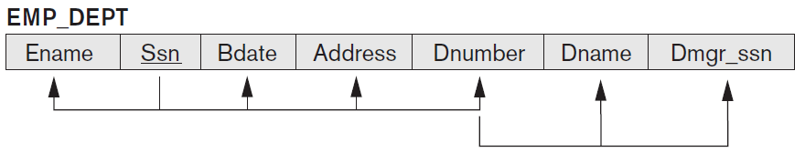
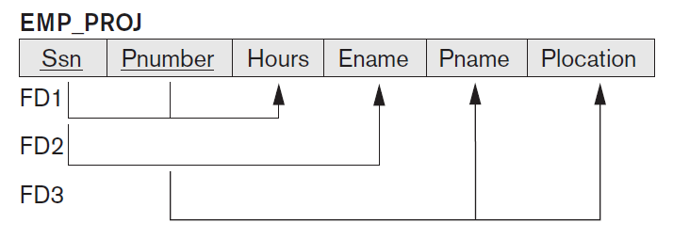

Slide 65
from the semantics of the attributes and the relation, we know that
Ssn → Ename
  alternatively, we say that Ename is functionally determined by (or functionally dependent on) Ssn, or given value of Ssn, we know value of Ename
Pnumber → {Pname, Plocation}
{Ssn, Pnumber} → Hours
value of employee’s Social Security number (Ssn) uniquely determines the employee name (Ename), value of a project’s number (Pnumber) uniquely determines the project name (Pname) and location (Plocation), and a combination of Ssn and Pnumber values uniquely determines the number of hours the employee currently works on project per week (Hours)

Slide 66
functional dependency is a property of the relation schema R, not of a particular legal relation state r of R
therefore, FD cannot be inferred automatically from a given relation extension r but must be defined explicitly by someone who knows semantics of attributes

Slide 67
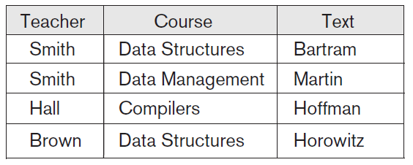
relation state of TEACH with possible functional dependency
TEXT → COURSE
ruled out:
TEACHER → COURSE

Slide 68
Normal Forms Based on Primary Keys
use functional dependencies to develop formal methodology for testing and improving relation schemas
assume that a set of functional dependencies is given for each relation and that each relation has designated primary key
drives the normalization process for relational schema design
useful to evaluate relations for goodness and decompose them further as needed to achieve higher normal forms using this normalization theory

Slide 69
Normalization of Relations
normalization process, as first proposed by Codd (1972a), takes a relation schema through a series of tests to certify whether it satisfies a certain normal form
process proceeds in a top-down fashion by evaluating each relation against the criteria for normal forms and decomposing relations as necessary, can thus, be considered as relational design by analysis

Slide 70
Normalization of Relations
initially, Codd proposed three normal forms: first, second, and third normal form
stronger definition of 3NF - called Boyce-Codd normal form (BCNF) - was proposed later
all these normal forms are based on functional dependencies among attributes of a relation
later, a fourth normal form (4NF) and a fifth normal form (5NF) were proposed, based on concepts of multivalued dependencies and join dependencies, respectively

Slide 71
Normalization
based on Functional Dependecies and primary keys to achieve the desirable properties of minimizing redundancy and minimizing the insertion, deletion, and update anomalies
unsatisfactory relation schema that does not meet condition for normal form is decomposed into smaller relation schemas that contain a subset of attributes and meet the test that was otherwise not met by the original relation

Slide 72
Normal Form
of a relation refers to highest normal form condition that it meets
indicates the degree to which it has been normalized
people tend to think in 3NF

Slide 73
superkey
superkey of relation schema R = {A₁, A₂, … , A_{n}} is a set of attributes S ⊆ R with property that no two tuples t₁ and t₂ in any legal relation state r of R will have t₁ [S] = t₂ [S]

Slide 74
key
key K is superkey with additional property that removal of any attribute from K will cause K not to be a superkey anymore
difference between a key and a superkey is that key has to be minimal; that is, if we have a key K = {A₁, A₂, … , A_{k}} of R, then K − {A_{i}} is not a key of R for any A_{i} , 1 ≤ i ≤ k
{Ssn} is a key for EMPLOYEE, whereas {Ssn}, {Ssn, Ename}, {Ssn, Ename, Bdate}, … are all superkeys

Slide 75
candidate key
{Ssn} {Ename, Bdate, Address}, … If a relation schema has more than one key, each is called a candidate key

Slide 76
Primary Key
{Ssn} {Ename, Bdate, Address}, … If a relation schema has more than one key, each is called a candidate key
one of the candidate keys is arbitrarily designated to be the primary key
in a practical relational database, each relation schema must have a primary key; if no candidate key is known for a relation, the entire relation can be treated as a default superkey
{Ssn} is the primary key of EMPLOYEE

Slide 77
secondary key
{Ssn} {Ename, Bdate, Address}, … If a relation schema has more than one key, each is called a candidate key
one of the candidate keys is arbitrarily designated to be the primary key, and the others are called secondary keys
in a practical relational database, each relation schema must have a primary key; if no candidate key is known for a relation, the entire relation can be treated as a default superkey

Slide 78
an attribute of relation schema R is called prime attribute of R if it is a member of some candidate key of R
an attribute is called nonprime if it is not a prime attribute, that is, if it is not a member of any candidate key
Ssn and Pnumber are prime attributes of WORKS_ON, other attributes of WORKS_ON are nonprime

Slide 79
First Normal Form (1NF)
is now considered to be part of formal definition of relation in the basic (flat) relational model
historically, it was defined to disallow multivalued attributes, composite attributes, and their combinations
states that the domain of an attribute must include only atomic (simple, indivisible) values and that value of any attribute in tuple must be a single value from the domain of that attribute
disallows having a set of values as attribute value for a single tuple

Slide 80
First Normal Form (1NF)
disallows relations within relations or relations as attribute values within tuples
only attribute values permitted by 1NF are single atomic values
PostGreSQL allows columns of a table to be defined as variable-length multidimensional arrays

Slide 81
consider the DEPARTMENT relation schema
suppose that we extend it by including Dlocations attribute and assume that each department can have a number of locations
DEPARTMENT schema and sample relation state are shown next
this is not in 1NF because Dlocations is not an atomic attribute,

Slide 82
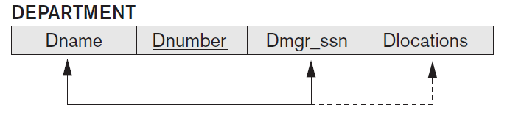
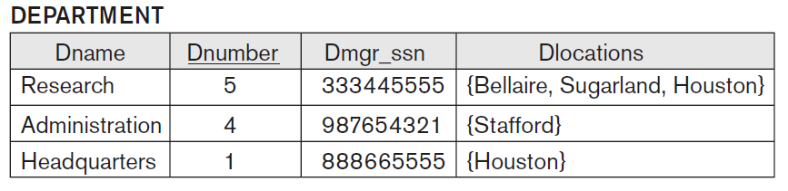

Slide 83
domain of Dlocations contains atomic values, but some tuples can have set of these values; Dlocations is not functionally dependent on primary key Dnumber
domain of Dlocations contains sets of values and hence is nonatomic; in this case, Dnumber → Dlocations because each set is considered a single member of attribute domain
in either case, DEPARTMENT relation is not in 1NF; in fact, it does not even qualify as a relation according to definition of relation
three main techniques to achieve first normal form for such a relation

Slide 84
1. Normal
remove attribute Dlocations that violates 1NF and place it in a separate relation DEPT_LOCATIONS along with primary key Dnumber of DEPARTMENT
primary key of this newly formed relation is the combination {Dnumber, Dlocation}
distinct tuple in DEPT_LOCATIONS exists for each location of a department
decomposes the non-1NF relation into two 1NF relations

Slide 85
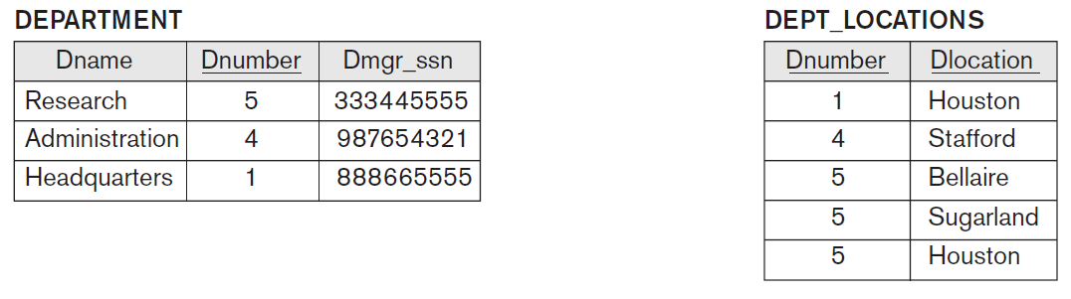

Slide 86
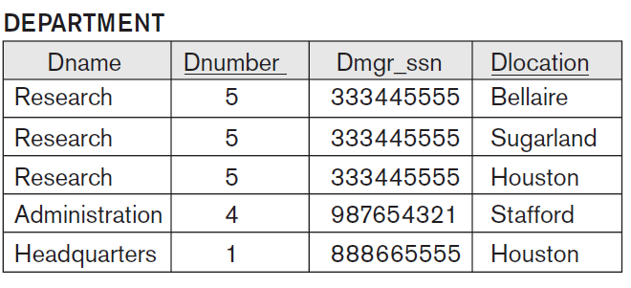
2. DeNormalize - redundancy
expand the key so that there will be a separate tuple in original DEPARTMENT relation for each location of a DEPARTMENT
primary key becomes the combination {Dnumber, Dlocation}
solution has the disadvantage of introducing redundancy in the relation and hence is rarely adopted

Slide 87
3.
if a maximum number of values is known for the attribute, replace the Dlocations attribute by three atomic attributes: Dlocation1, Dlocation2, and Dlocation3
solution has the disadvantage of introducing NULL values if most departments have fewer than three locations
further introduces spurious semantics about the ordering among the location values; that ordering is not originally intended
querying on this attribute becomes more difficult
for all these reasons, it is best to avoid this alternative

Slide 88
MongoDB allow nested documents / relations / entitites
in MongoDB, nested documents are documents embedded within other documents, allowing you to create complex, hierarchical data structures
unlike traditional relational databases, MongoDB provides native support for nested data, which offers greater flexibility in data modeling

Slide 89
relations that involve attributes that go beyond just numeric and character string data - it is becoming common in today’s databases to incorporate images, documents, video / audio clips, ...
when these are stored in relation, the entire object or file is treated as atomic value, which is stored as a BLOB (Binary Large OBject) or CLOB (Character Large OBject) data type using SQL
such object is treated as an atomic, single-valued attribute and hence it maintains the 1NF status of the relation

Slide 90
Second Normal Form (2NF)
based on the concept of full functional dependency – a functional dependency X → Y is a full functional dependency if removal of any attribute A from X means that the dependency does not hold anymore
for any attribute A ε X, (X − {A}) does not functionally determine Y
a functional dependency X → Y is a partial dependency if some attribute A ε X can be removed from X and dependency still holds
for some A ε X, (X − {A}) → Y

Slide 91
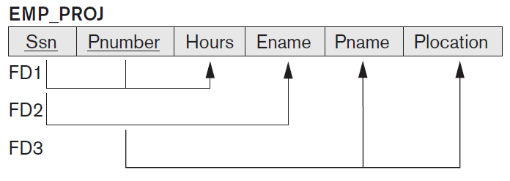
{Ssn, Pnumber} → Hours is a full dependency (neither Ssn → Hours nor Pnumber → Hours holds)
{Ssn, Pnumber} → Ename is partial dependency because Ssn → Ename holds

Slide 92
Second Normal Form (2NF) definition
a relation schema R is in 2NF if every nonprime attribute A in R is fully functionally dependent on the primary key of R
test for 2NF involves testing for functional dependencies whose left-hand side attributes are part of primary key
if primary key contains a single attribute, test need not be applied at all

Slide 93
EMP_PROJ relation is in 1NF but is not in 2NF
nonprime attribute Ename violates 2NF because of FD2,
nonprime attributes Pname and Plocation violates 2NF because of FD3
if relation schema is not in 2NF, it can be second normalized or 2NF normalized into a number of 2NF relations in which nonprime attributes are associated only with the part of the primary key on which they are fully functionally dependent
functional dependencies FD1, FD2, and FD3 lead to the decomposition of EMP_PROJ into the three relation schemas EP1, EP2, and EP3

Slide 94
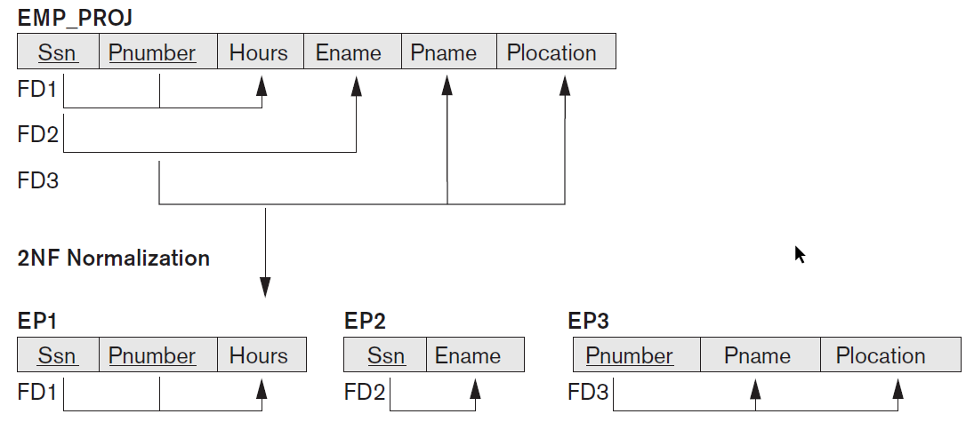

Slide 95
Third Normal Form (3NF)
based on the concept of transitive dependency; functional dependency X → Y in a relation schema R is a transitive dependency if there exists a set of attributes Z in R that is neither a candidate key nor a subset of any key of R, and both X → Z and Z → Y hold

Slide 96
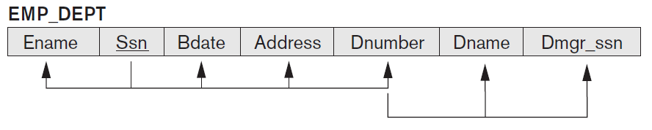
Third Normal Form (3NF)
dependency Ssn → Dmgr_ssn is transitive through Dnumber in EMP_DEPT, because both the dependencies Ssn → Dnumber and Dnumber → Dmgr_ssn hold and Dnumber is neither a key itself nor a subset of the key of EMP_DEPT
intuitively, we can see that the dependency of Dmgr_ssn on Dnumber is undesirable in EMP_DEPT since Dnumber is not a key of EMP_DEPT

Slide 97
Third Normal Form (3NF) definition
relation schema R is in 3NF if it satisfies 2NF and no nonprime attribute of R is transitively dependent on the primary key

Slide 98
relation schema EMP_DEPT is in 2NF, since no partial dependencies on a key exist; however, EMP_DEPT is not in 3NF because of the transitive dependency of Dmgr_ssn (and also Dname) on Ssn via Dnumber
can normalize EMP_DEPT by decomposing it into two 3NF relation schemas ED1 and ED2 - ED1 and ED2 represent independent facts about employees and departments, both of which are entities in their own right;
a NATURAL JOIN operation on ED1 and ED2 will recover the original relation EMP_DEPT without generating spurious tuples

Slide 99
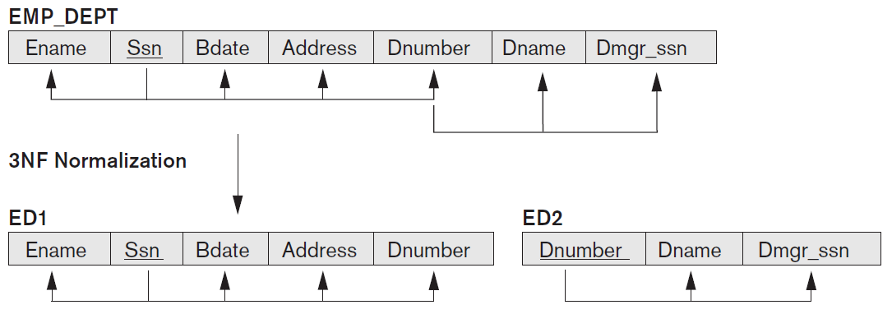

Slide 100
Normal Form) | Test | Normalization
First (1NF) | Relation should have no multivalued attributes or nested relations | Form new relations for each multivalued attribute or nested relation
Second (2NF) | For relations where primary key contains multiple attributes, no nonkey attribute should be functionally dependent on part of primary key | Decompose and set up new relation for each partial key with its dependent attribute(s). Make sure to keep a relation with original primary key and any attributes that are fully functionally dependent on it
Third (3NF) | Relation should not have nonkey attribute functionally determined by another nonkey attribute (or by set of nonkey attributes). That is, there should be no transitive dependency of nonkey attribute on primary key | Decompose and set up relation that includes nonkey attribute(s) that functionally determine(s) other nonkey attribute(s)

Slide 101
design relation schemas so that they have neither partial nor transitive dependencies because these types of dependencies cause the update anomalies
these definitions, however, do not take other candidate keys of a relation, if any, into account
more general definitions of 2NF and 3NF that take all candidate keys of a relation into account
prime attribute - attribute that is part of any candidate key will be considered as prime - partial and full functional dependencies and transitive dependencies will now be considered with respect to all candidate keys of a relation

Slide 102
General Definition of Second Normal Form 2NF
relation schema R is in second normal form (2NF) if every nonprime attribute A in R is not partially dependent on any key of R
test for 2NF involves testing for functional dependencies whose left-hand side attributes are part of primary key; if primary key contains a single attribute, test need not be applied at all
relation schema R is in 2NF if every nonprime attribute A in R is fully functionally dependent on every key of R

Slide 103
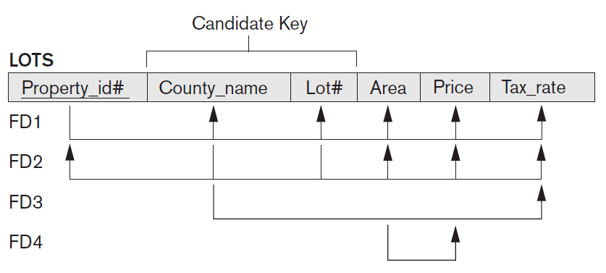

Slide 104
relation schema LOTS describes parcels of land for sale in various counties of a state
two candidate keys: Property_id# and {County_name, Lot#}; that is, lot numbers are unique only within each county, but Property_id# numbers are unique across counties for entire state

Slide 105
choose Property_id# as primary key, so it is underlined
following additional functional dependencies hold in LOTS:
FD3: County_name → Tax_rate
FD4: Area → Price
dependency FD3 says that tax rate is fixed for a given county (does not vary lot by lot within the same county)
dependency FD4 says that price of lot is determined by its area regardless of which county it is in - price of lot for tax purposes
LOTS relation schema violates general definition of 2NF because Tax_rate is partially dependent on candidate key {County_name, Lot#}, due to FD3

Slide 106
to normalize LOTS into 2NF, we decompose it into two relations LOTS1 and LOTS2,
LOTS1 by removing attribute Tax_rate that violates 2NF from LOTS and placing it with County_name (left-hand side of FD3 that causes partial dependency) into another relation LOTS2
both LOTS1 and LOTS2 are in 2NF
FD4 does not violate 2NF and is carried over to LOTS1

Slide 107
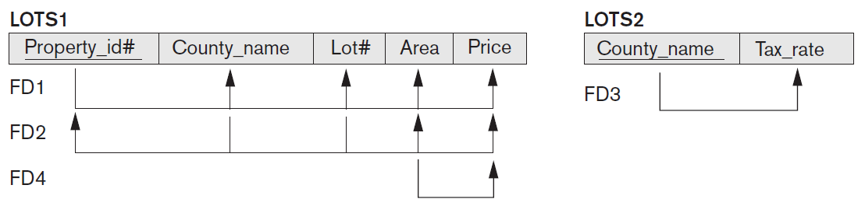
Decomposing into 2NF relations LOTS1 and LOTS2

Slide 108
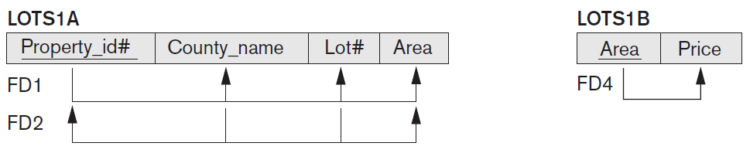
Decomposing LOTS1 into 3NF relations LOTS1A and LOTS1B normalization of LOTS into 3NF design

Slide 109
General Definition of Third Normal Form 3NF
relation schema R is in third normal form (3NF) if, whenever a nontrivial functional dependency X → A holds in R, either (a) X is a superkey of R, or (b) A is a prime attribute of R

Slide 110
according to this definition LOTS2 is in 3NF but FD4 in LOTS1 violates 3NF because Area is not a superkey and Price is not a prime attribute in LOTS1
to normalize LOTS1 into 3NF, we decompose it into relation schemas LOTS1A and LOTS1B
construct LOTS1A by removing attribute Price that violates 3NF from LOTS1 and placing it with Area (the left-hand side of FD4 that causes the transitive dependency) into another relation LOTS1B
both LOTS1A and LOTS1B are in 3NF

Slide 111
this general definition can be applied directly to test whether a relation schema is in 3NF; it does not have to go through 2NF first
if relation passes general 3NF test, then it automatically passes 2NF test
if apply the above 3NF definition to LOTS with dependencies FD1 through FD4, we find that both FD3 and FD4 violate 3NF by general definition because the LHS County_name in FD3 is not a superkey
decompose LOTS into LOTS1A, LOTS1B, and LOTS2 directly
transitive and partial dependencies that violate 3NF can be removed in any order

Slide 112
if apply the above 3NF definition to LOTS with dependencies FD1 through FD4, we find that both FD3 and FD4 violate 3NF by general definition because the LHS County_name in FD3 is not a superkey
decompose LOTS into LOTS1A, LOTS1B, and LOTS2 directly
transitive and partial dependencies that violate 3NF can be removed in any order

Slide 113
General Definition of Third Normal Form 3NF
relation schema R violates the general definition of 3NF if a functional dependency X → A holds in R that meets either of the two conditions:
  a nonprime attribute determines another nonprime attribute
    have a transitive dependency that violates 3NF
  a proper subset of a key of R functionally determines a nonprime attribute
    have a partial dependency that violates 2NF
addresses the problematic dependencies that were causes for second and third normalization

Slide 114
General alternative Definition of
Third Normal Form 3NF
relation schema R is in 3NF if every nonprime attribute of R meets both of the following conditions:
it is fully functionally dependent on every key of R.
it is nontransitively dependent on every key of R.
note that the last clause in the general definition of 3NF allows certain functional dependencies to slip through or escape in that they are OK with the 3NF definition and hence are not “caught” by the 3NF definition even though they may be potentially problematic
Boyce-Codd normal form “catches” these dependencies in that it does not allow them

Slide 115
Boyce-Codd normal form (BCNF)
proposed as a simpler form of 3NF, but it was found to be stricter than 3NF
every relation in BCNF is also in 3NF;
relation in 3NF is not necessarily in BCNF
3NF allows functional dependencies that conform to last clause in 3NF definition, BCNF disallows them and hence is a stricter definition of a normal form

Slide 116
suppose that we have thousands of lots in relation but the lots are from only two counties; suppose also that lot sizes in first county are only 0.5, 0.6, 0.7, 0.8, 0.9, and 1.0 acres, whereas lot sizes in second county are restricted to 1.1, 1.2, … , 1.9, and 2.0 acres
have additional functional dependency FD5: Area → County_name
add this to other dependencies, relation schema LOTS1A still is in 3NF because this FD conforms to clause in the general definition of 3NF, County_name being a prime attribute

Slide 117
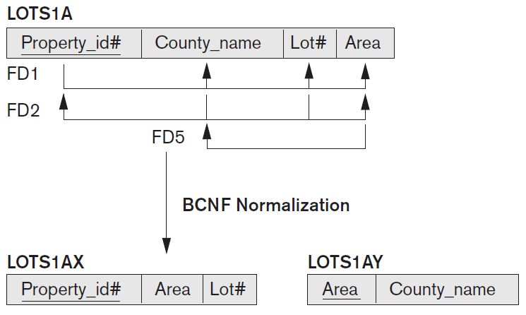

Slide 118
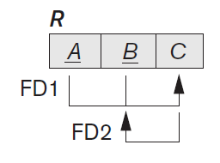
area of a lot that determines county, as specified by FD5, can be represented by tuples in a separate relation R(Area, County_name)
representation reduces redundancy of repeating same information in the many thousands of LOTS1A tuples
BCNF is a stronger normal form that would disallow LOTS1A and suggest the need for decomposing it

Slide 119
Definition of Boyce Codd Normal Form BCNF
relation schema R is in BCNF if whenever a nontrivial functional dependency X → A holds in R, then X is a superkey of R

Slide 120
in our example, FD5 violates BCNF in LOTS1A because Area is not a superkey of LOTS1A
decompose LOTS1A into two BCNF relations LOTS1AX and LOTS1AY
decomposition loses the functional dependency FD2 because its attributes no longer coexist in same relation after decomposition

Slide 121
in practice, most relation schemas that are in 3NF are also in BCNF
only if there exists some FD X → A that holds in a relation schema R with X not being a superkey and A being a prime attribute will R be in 3NF but not in BCNF
such FD leads to potential redundancy of data

Slide 122
ideally, relational database design should strive to achieve BCNF or 3NF for every relation schema
achieving the normalization status of just 1NF or 2NF is not considered adequate, since both were developed historically to be intermediate normal forms as stepping stones to 3NF and BCNF

Slide 123

Decomposition of Relations in BCNF
another example, relation TEACH with following dependencies:
FD1: {Student, Course} → Instructor
FD2:14 Instructor → Cours

Slide 124
{Student, Course} is a candidate key
functional dependencies follow BCNF pattern - relation is in 3NF but not BCNF
may be decomposed into one of following possible pairs:
R1 (Student, Instructor) and R2(Student, Course)
R1 (Course, Instructor) and R2(Course, Student)
R1 (Instructor, Course) and R2(Instructor, Student)

Slide 125
all three decompositions lose functional dependency FD1
which of the above three is a desirable decomposition
strive to meet two properties of decomposition during normalization process: nonadditive join property and functional dependency preservation property - not able to meet functional dependency preservation for any of the above BCNF decompositions; but we must meet nonadditive join property

Slide 126
Nonadditive Join Test for Binary Decompositions
decomposition D = {R1, R2} of R has the lossless (nonadditive) join property with respect to a set of functional dependencies F on R if and only if either
FD ((R1 ∩ R2) → (R1 − R2)) is in F⁺
FD ((R1 ∩ R2) → (R2 − R1)) is in F⁺
find that only the third decomposition meets the test
the R1 ∩ R2 for the above test is Instructor and R1 − R2 is Course
because Instructor → Course, the NJB test is satisfied and decomposition is nonadditive

Slide 127
notation F⁺ refers to the cover of the set of functional dependencies and includes all FD implied by F

Slide 128
the proper decomposition for relation TEACH with following dependencies:
FD1: {Student, Course} → Instructor
FD2:14 Instructor → Cours
into BCNF relations is:
TEACH1 (Instructor, Course)
TEACH2 (Instructor, Student)

Slide 129
Multivalued Dependency
consider the relation EMP - tuple represents the fact that an employee whose name is Ename works on the project whose name is Pname and has a dependent whose name is Dname
employee may work on several projects and employee may have several dependents, and employee’s projects and dependents are independent of one another

Slide 130
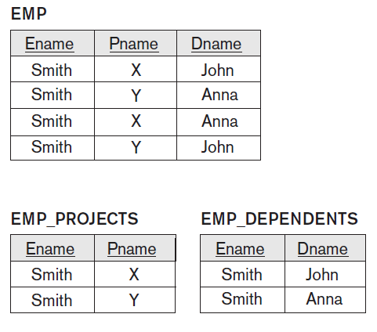

Slide 131
must have a separate tuple to represent every combination of employee’s dependent and employee’s project
in EMP relation employee with Ename Smith works on two projects ‘X’ and ‘Y’ and has two dependents ‘John’ and ‘Anna’, and therefore there are four tuples to represent these facts together
relation EMP is an all-key relation (with key made up of all attributes) and therefore has no FD and as such qualifies to be a BCNF relation
can see that there is an obvious redundancy in relation EMP, dependent information is repeated for every project and project information is repeated for every dependent

Slide 132
concept of multivalued dependency (MVD) was proposed and, based on this dependency, the fourth normal form was defined
multivalued dependencies are a consequence of first normal form (1NF) which disallows attribute in tuple to have set of values
whenever two independent 1:N relationships A:B and A:C are mixed in the same relation, R(A, B, C), an MVD may arise
Pizza(Restaurant, Type, Delivery_Area)
there could be cases – business rules – in which restaurant Suete will deliver pizza calzone only in Grigorescu

Slide 133
Definition of Multivalued Dependency
a multivalued dependency X →→ Y specified on relation schema R, where X and Y are both subsets of R, specifies the following constraint on any relation state r of R:
if two tuples t₁ and t₂ exist in r such that t₁[X] = t₂[X], then two tuples t₃ and t₄ should also exist in r with following properties – where we use Z to denote (R − (X ∪ Y)):
t₃[X] = t₄[X] = t₁ [X] = t₂[X]
t₃[Y] = t₁[Y] and t₄[Y] = t₂[Y]
t₃[Z] = t₂[Z] and t₄[Z] = t₁ [Z]

Slide 134
whenever X →→ Y holds, we say that X multidetermines Y
because of the symmetry in the definition, whenever X →→ Y holds in R, so does X →→ Z
sometimes written as X →→ Y|Z

Slide 135
a MVD X →→ Y in R is called trivial MVD if Y is a subset of X, or X ∪ Y = R
for example,
relation EMP_PROJECTS has the trivial MVD Ename →→ Pname and relation EMP_DEPENDENTS has the trivial MVD Ename →→ Dname
it is called trivial because it does not specify any significant or meaningful constraint on R

Slide 136
if we have nontrivial MVD in relation, we may have to repeat values redundantly in tuples
need to define a fourth normal form that is stronger than BCNF and disallows relation schemas with nontrivial MVD such as EMP
relations containing nontrivial MVDs tend to be all-key relations, that is, their key is all their attributes taken together
recognition of MVDs as a potential problematic dependency is essential in relational design

Slide 137
definition of fourth normal form (4NF)
relation has undesirable multivalued dependencies and hence can be used to identify and decompose such relations
relation schema R is in 4NF with respect to a set of dependencies F (that includes functional dependencies and multivalued dependencies) if, for every nontrivial multivalued dependency X →→ Y in F⁺, X is a superkey for R

Slide 138
all-key relation is always in BCNF since it has no FDs
all-key relation such as EMP relation, which has no FDs but has the MVD Ename →→ Pname | Dname, is not in 4NF.
relation that is not in 4NF due to a nontrivial MVD must be decomposed to convert it into set of relations in 4NF
decomposition removes the redundancy caused by the MVD.

Slide 139
decompose EMP into EMP_PROJECTS and EMP_DEPENDENTS
EMP_PROJECTS and EMP_DEPENDENTS are in 4NF, because MVDs Ename →→ Pname in EMP_PROJECTS and Ename →→ Dname in EMP_DEPENDENTS are trivial MVDs
no other nontrivial MVDs hold in either EMP_PROJECTS or EMP_DEPENDENTS
no FDs hold in these relation schemas either

Slide 141
Join Dependencies
functional dependencies, multivalued dependencies
decompositions
  must obey the Nonadditive Join property
in some cases, there may be no nonadditive join decomposition of R into two relation schemas, but there may be a nonadditive join decomposition into more than two relation schemas

Slide 142
another dependency called the join dependency and, if it is present, carry out a multiway decomposition into fifth normal form (5NF)
important to note that such dependency is a peculiar semantic constraint that is difficult to detect in practice; therefore, normalization into 5NF is rarely done in practice

Slide 143
Definition Join Dependency
denoted by JD(R₁, R₂, … , R_{n}), specified on relation schema R, specifies a constraint on the states r of R
constraint states that every legal state r of R should have a nonadditive join decomposition into R₁, R₂, … , R_{n}
hence, for every such r we have
* (π_{R1}(r), π_{R2}(r), … , π_{Rn}(r)) = r
notice that an MVD is a special case of a JD where n = 2

Slide 144
Definition of fifth normal form (5NF)
(or project-join normal form (PJNF)
relation schema R is in fifth normal form (5NF) (or project-join normal form (PJNF)) with respect to a set F of functional, multivalued, and join dependencies if, for every nontrivial join dependency JD(R₁, R₂, … , R_{n}) in F⁺ (that is, implied by F), every R_{i} is a superkey of R

Slide 145
SUPPLY all-key relation with additional constraint: whenever
supplier s supplies part p, and
project j uses part p, and
supplier s supplies at least one part to project j,
then supplier s will also be supplying part p to project j
constraint can be restated in other ways and specifies a join dependency JD(R₁, R₂, R₃) among the three projections R₁(Sname, Part_name), R₂(Sname, Proj_name), and R₃(Part_name, Proj_name) of SUPPLY

Slide 146
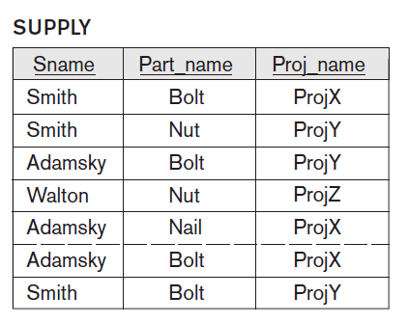

Slide 147
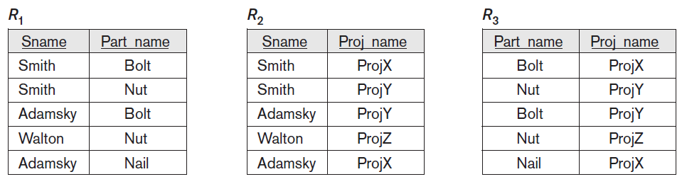

Slide 148
applying a natural join to any two of these relations produces spurious tuples, but applying a natural join to all three together does not produces spurious tuples
the JD(R1, R2, R3) is specified on all legal relation states, not just on the one shown
discovering JDs in practical databases with hundreds of attributes is next to impossible; can be done only with a great degree of intuition about the data on the part of the designer
therefore, current practice of database design pays scant attention to them

Slide 149
one scientific result due to Date and Fagin (1992) relates to conditions detected using functional dependencies alone and it states:
“If a relation schema is in 3NF and each of its keys consists of a single attribute, it is also in 5NF.”

